Slide 1

BRITISH AIRWAYS CUSTOMER BEHAVIOURS
Predictive model to understand factors that influence buying behaviour

Slide 2
Title and Content Layout with List
Exploratory Data Analysis
Encoding Categorical Column
Building a Predictive model
Finding Feature Impotance

Slide 3
Exploratory Data Analysis

Slide 4
Exploratory Data Analysis
Successful Booking Origin Distribution

Slide 5
Exploratory Data Analysis
Flight Day Distribution

Slide 6
Exploratory Data Analysis

Slide 7
Exploratory Data Analysis

Slide 8
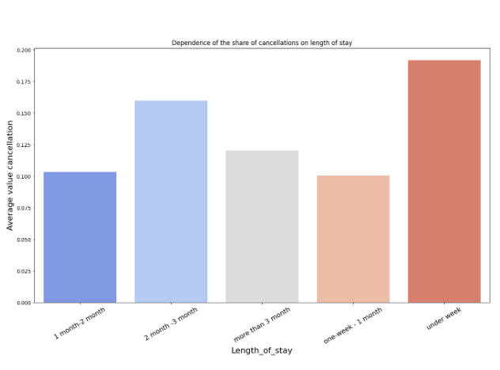
Feature Encoding
Binning the Numerical Data Length of Stay into Categorical Data

Slide 9
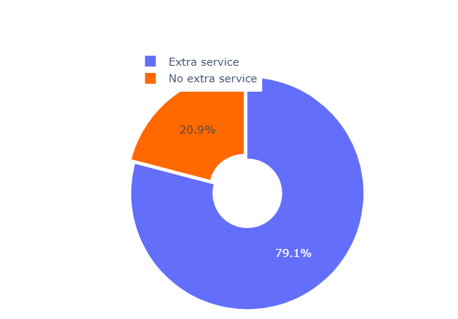
Feature Encoding
Combining Extra Baggage Service and Meal Service Into Extra Service feature

Slide 10
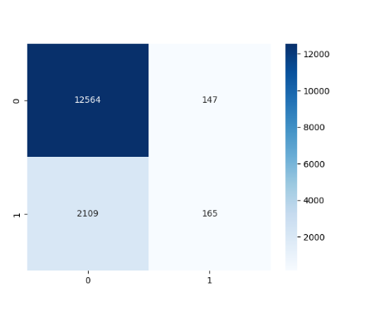
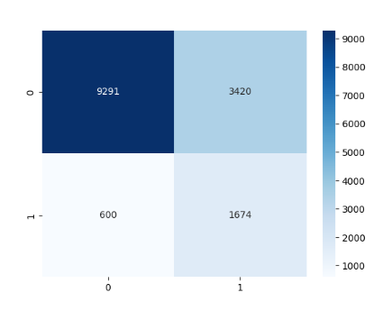
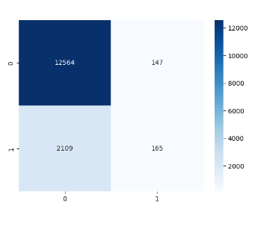
Model Building
Logistic Regression
Random Forest Classifier
XGBoost Classifier

Slide 11
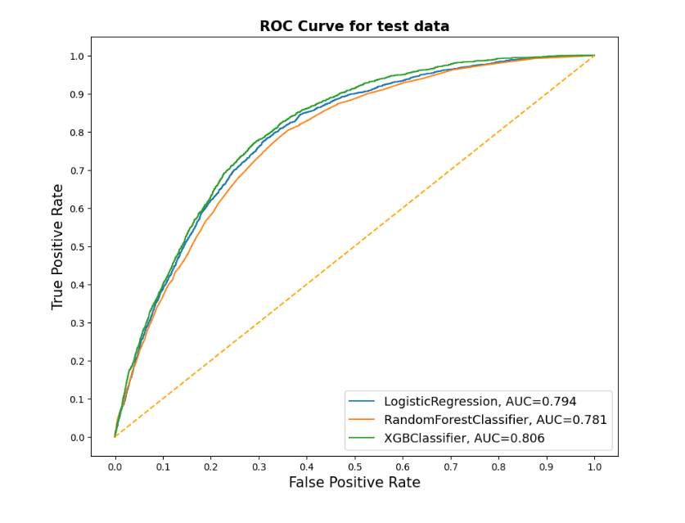
Model Building

Slide 12
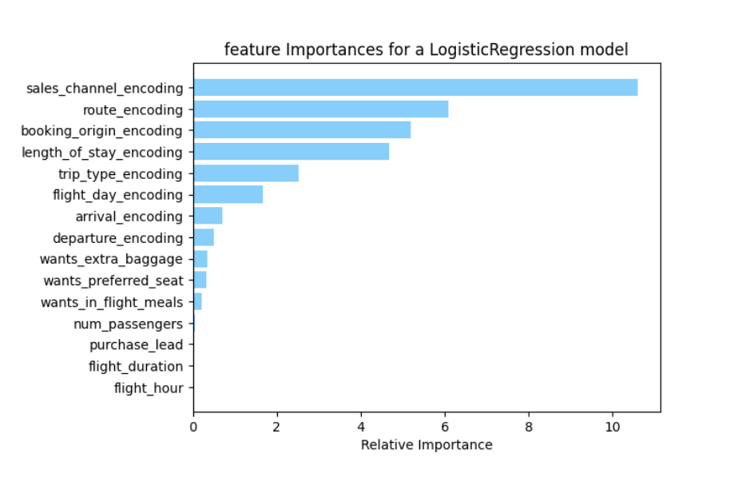
Feature Importance

Slide 13
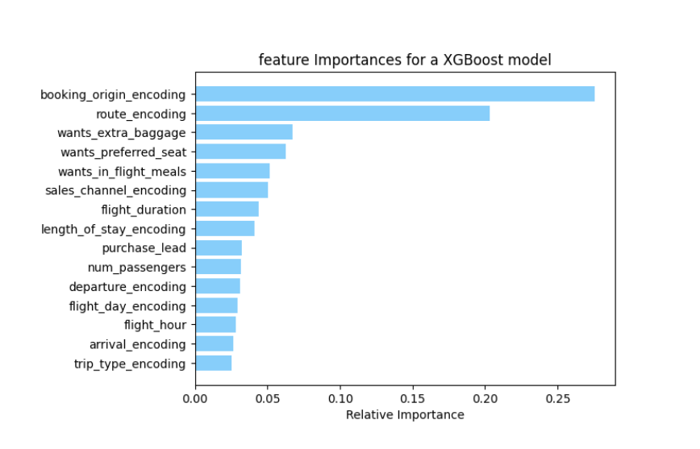
Feature Importance

Slide 14
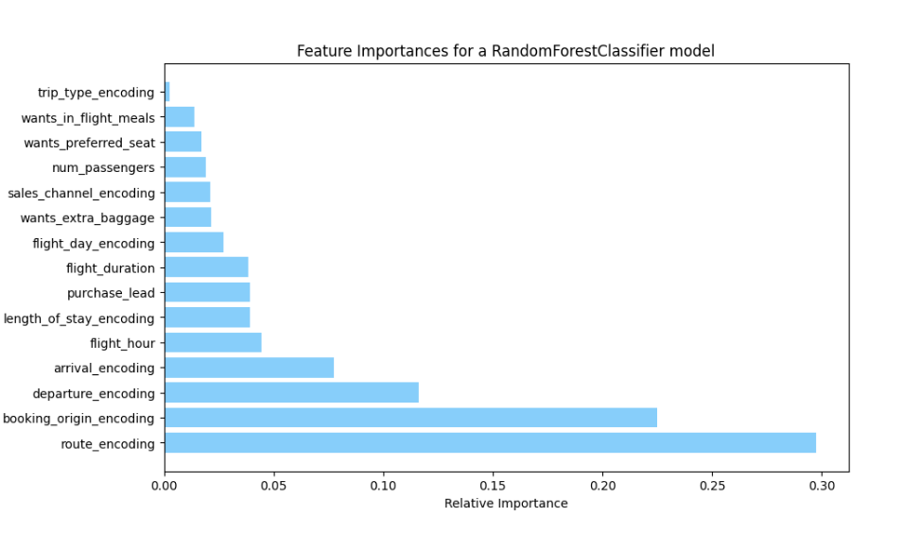
Feature Importance

Slide 15


